Slide 1
Identification of Thiol Function Groups in GRA 95229 and Murchison
Thomas Redford^{1,2}, Rob Root³, Maitrayee Bose¹
1) Center for Isotope Analysis, School of Earth and Space Exploration, ASU. 2) Department of Physics, ASU. 3) Department of Environmental Science, University of Arizona
Space Grant Symposium 4/17/2021

Slide 2
Big Questions about Sulfur-Bearing Organic Material
Why is it important?
What kinds of organic sulfurs are present?

Slide 3
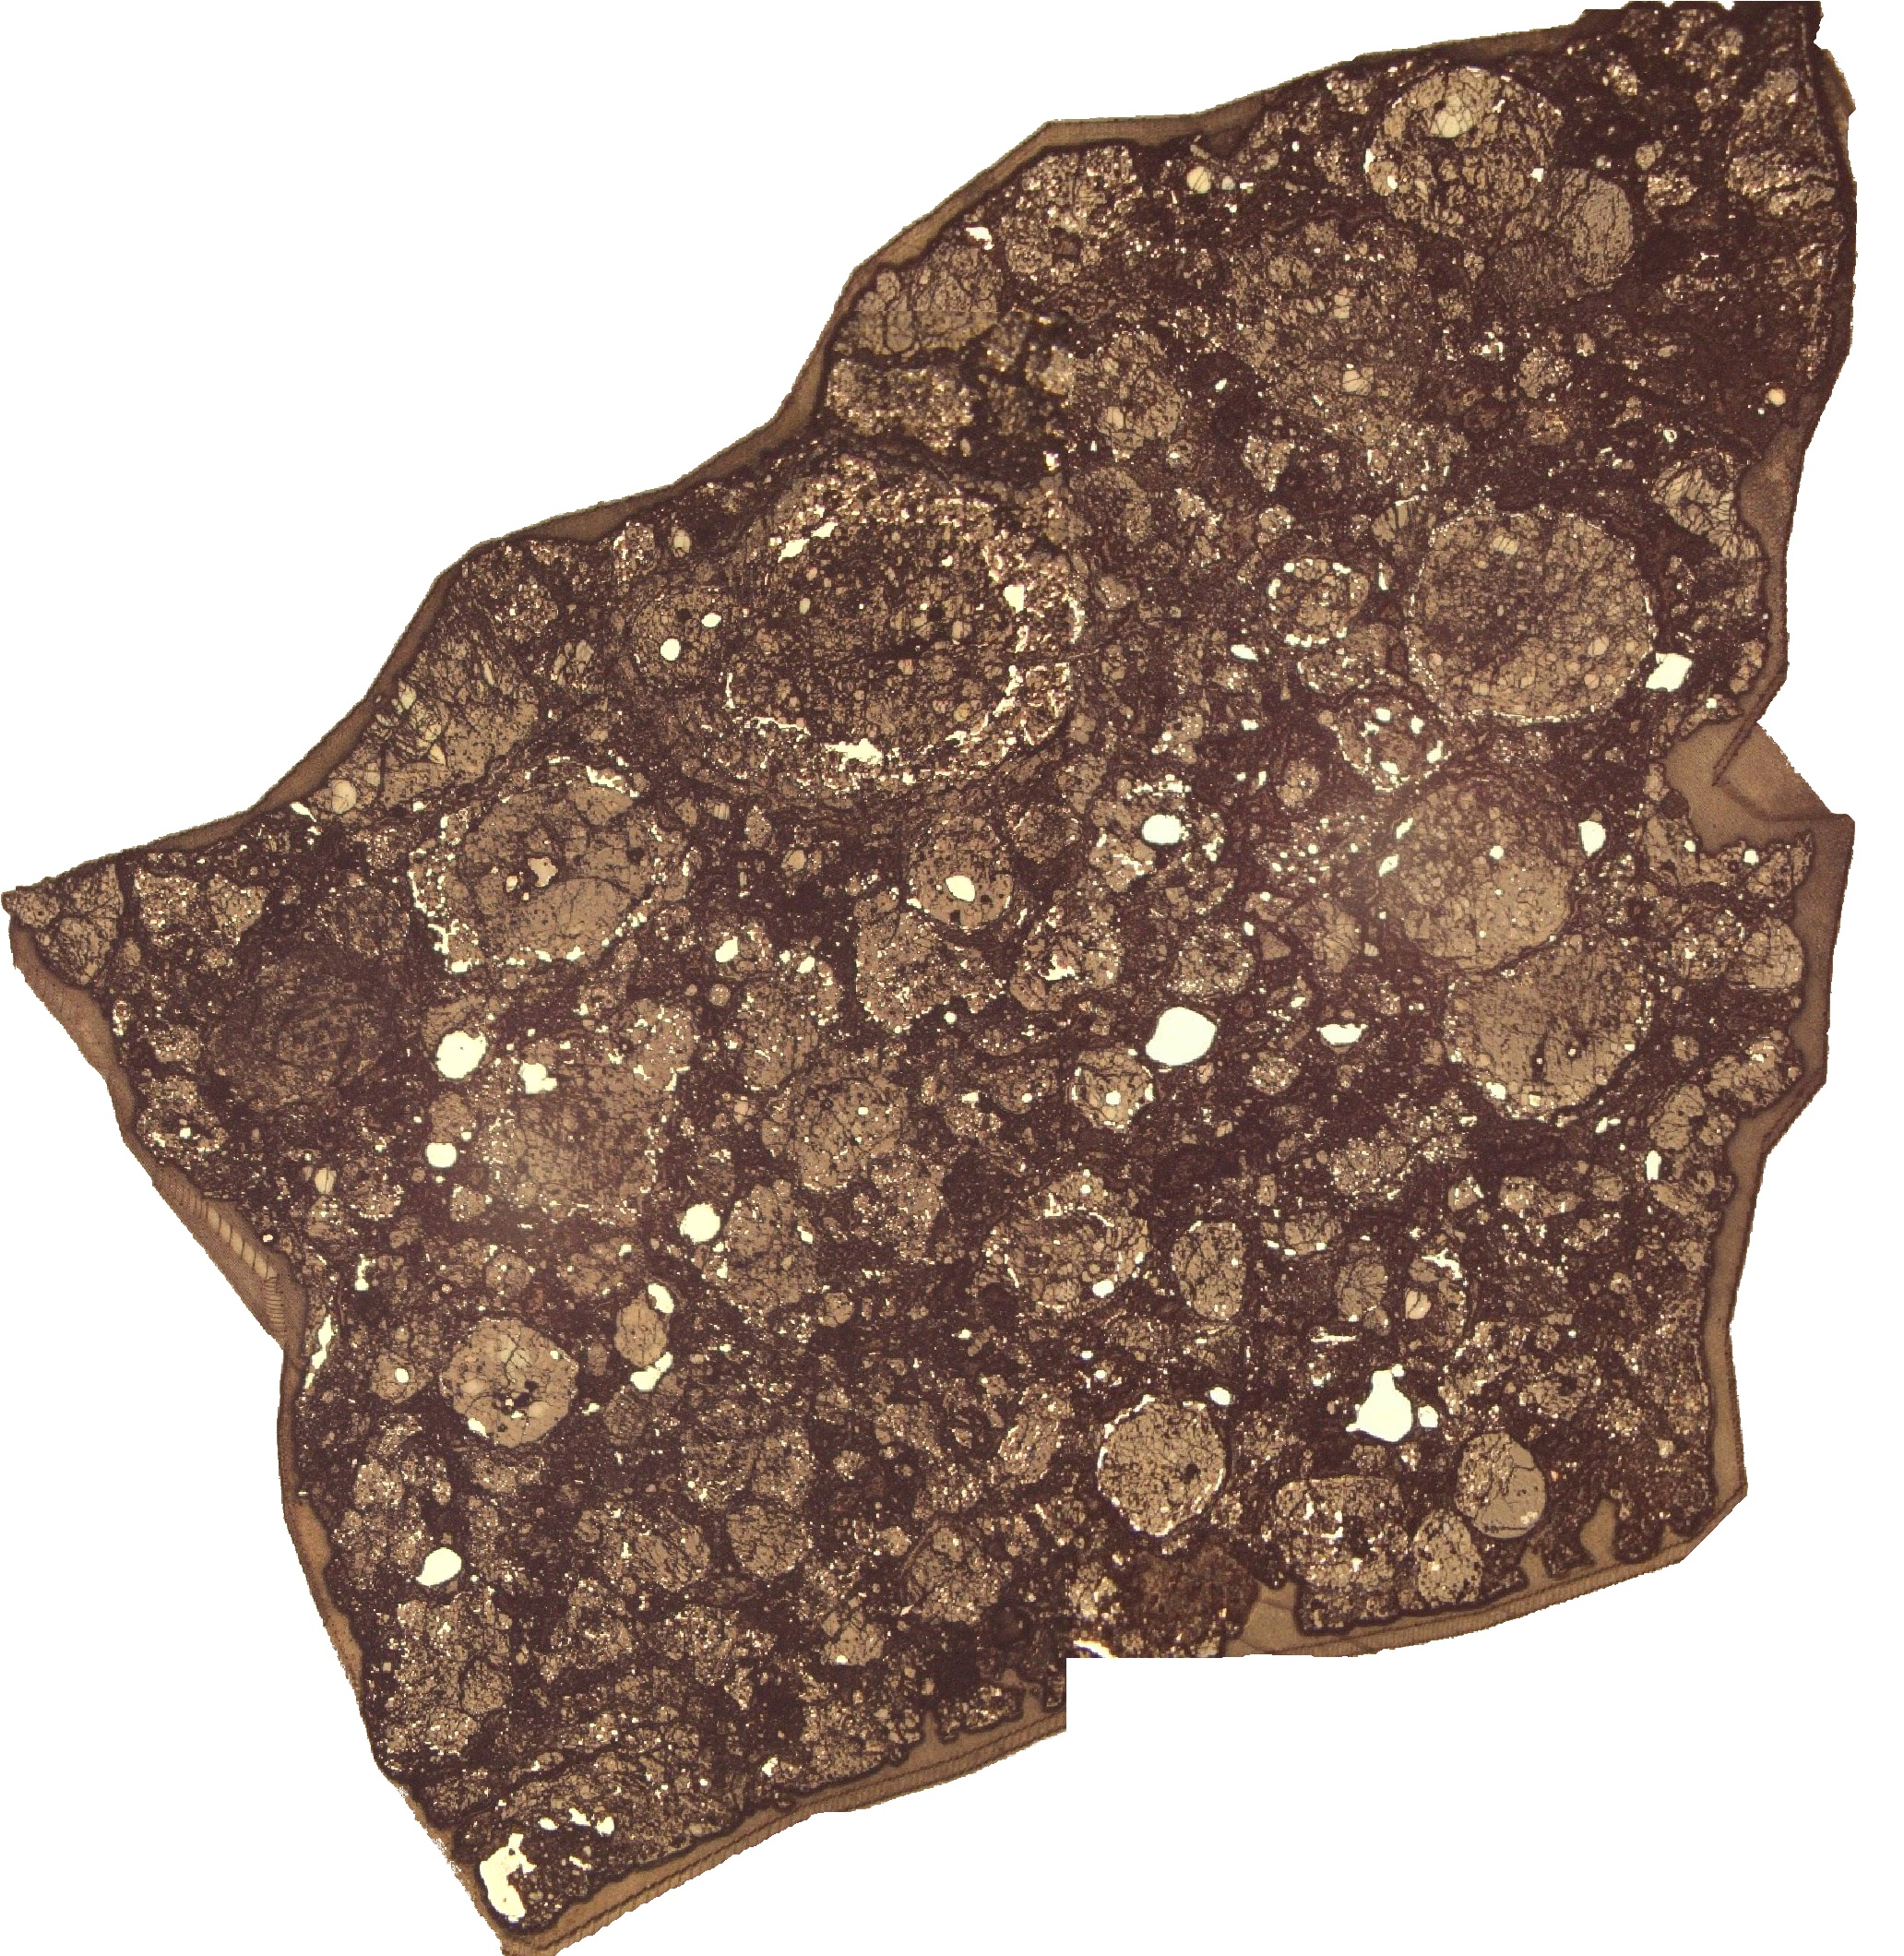
Samples
Carbon Rich CR2 Graves Nunataks 95229 (GRA 95229) and CM2 Murchison
High abundance of organic material
Both oxidized and reduced sulfur phases
Limited aqueous alteration
Reflected light microscope image of GRA 95229

Slide 4
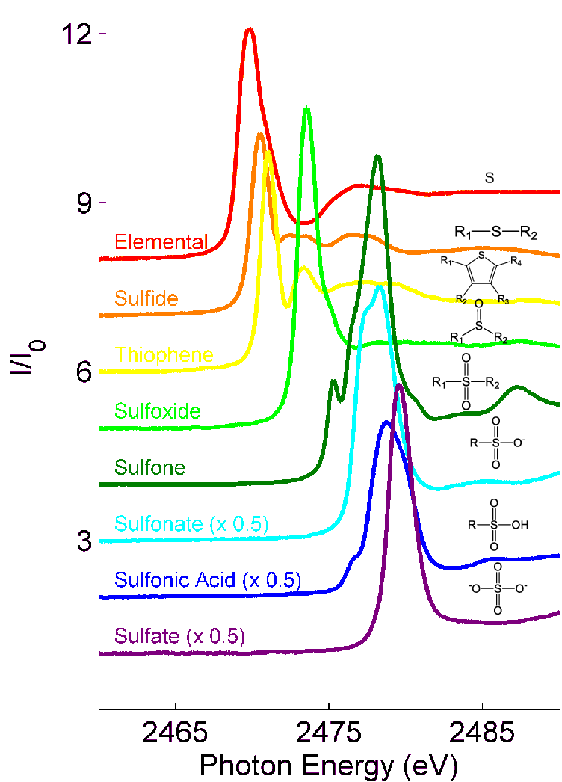
X-Ray Spectroscopy
Nondestructive, high resolution (3 – 5 µm), and in situ
X-Ray Absorption Near Edge Structure (XANES) -- More information, single point
Micro X-Ray Fluorescence (µXRF) -- Less information, larger area
Image source: Abdallah et al. (2017) SPE Middle East Oil & Gas Show and Conference

Slide 5
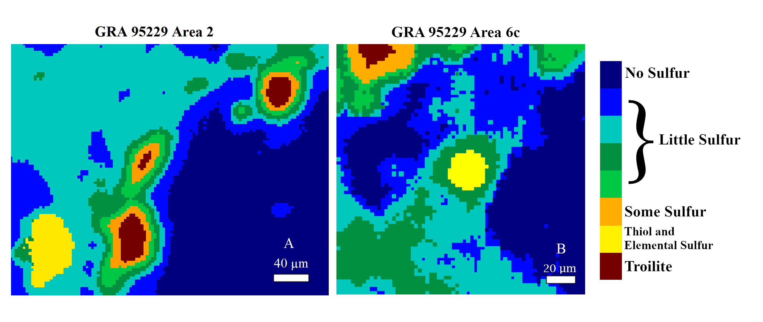
Results

Slide 6
Results
(1) Troilite. (2) Elemental Sulfur. (3) Thiol. (4) Sulfate.

Slide 7
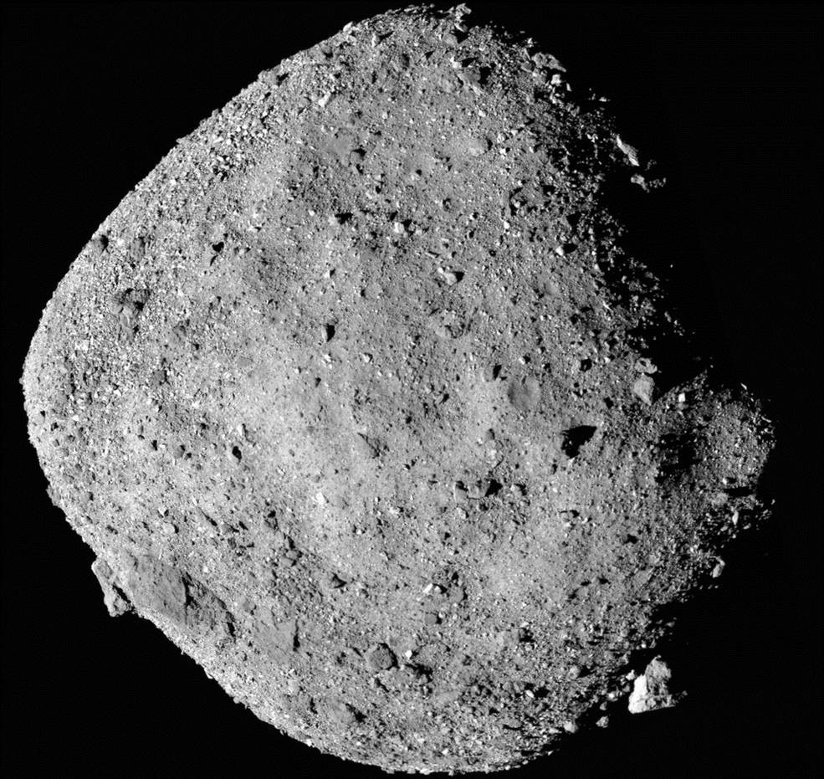
Implications
Thiols in hydrothermal Vents on the ocean floor and are a key part of early metabolic processes. Schulte and Rogers (2004) Geochimica et Cosmochimica Acta
Fluid inclusions in 3.5-billion-year-old rock have thiols showing their early importance. Mißbach et al. (2021) Nature Communications
Possibility of Thiols forming on asteroid parent bodies
101955 Bennu
Image courtesy of NASA

